Slide 1

LEXI Platform
Weekly Snapshot & Strategic Progress Overview

Slide 2
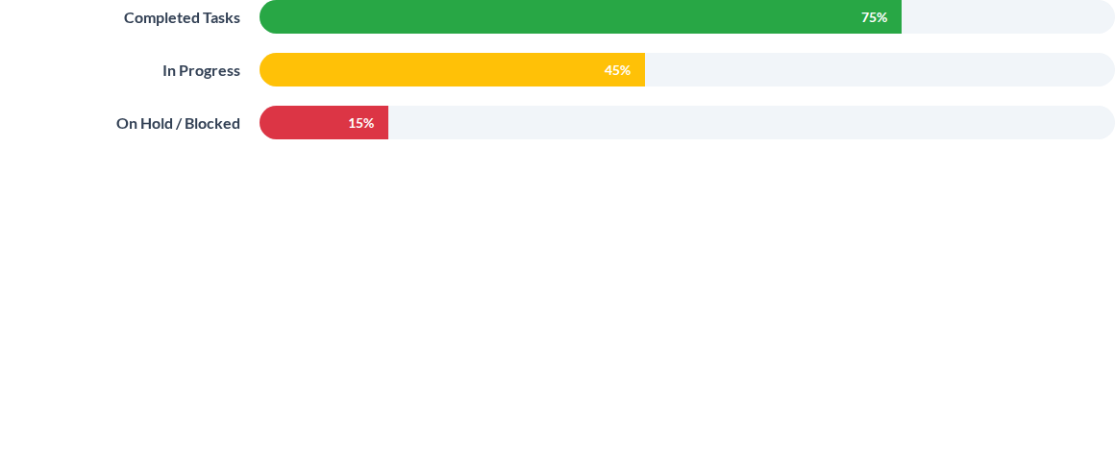
Weekly Snapshot: Execution Status
Note: On-hold items primarily due to transition delays and infrastructure dependencies.

Slide 3






Critical Blockers & Risks
Jenkins Server
Budget Refresh
Transition Phase
Hardware failure: Server currently OFF. Critical dependency for CI/CD pipelines.
Pending leadership approval for infrastructure refresh to resume full engineering velocity.
Ongoing risks in transitioning on-hold items to active sprints without dedicated platform support.

Slide 4
Customer Progress Overview
Customer / Project | Implementation Stream | Weekly Focus
TAFE | GENUE Integration | Core capability alignment & Samil bar validation.
Renault | AI Diagnostics Development | Diagnostic module testing & Platform readiness.
DevSecOps | Cybersecurity Pipeline | Security gate automation & vulnerability scanning.

Slide 5
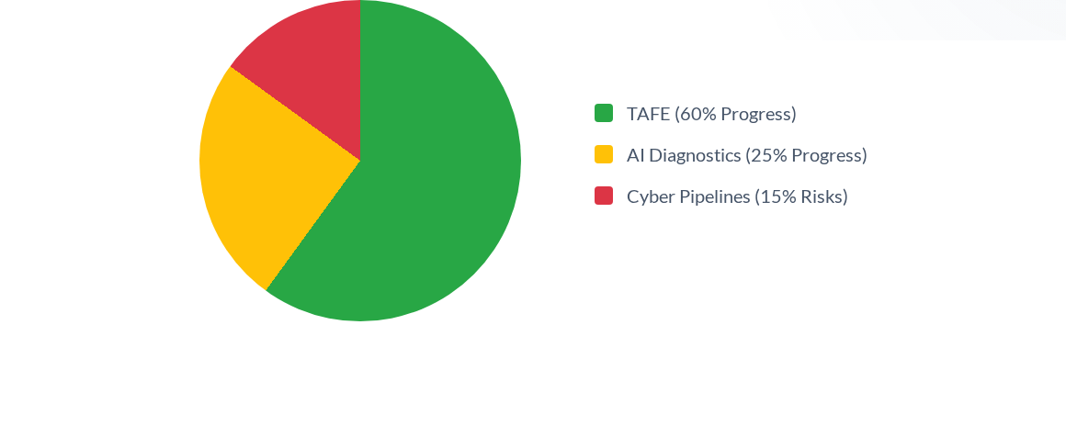
Customer Status: Implementation Completion

Slide 6
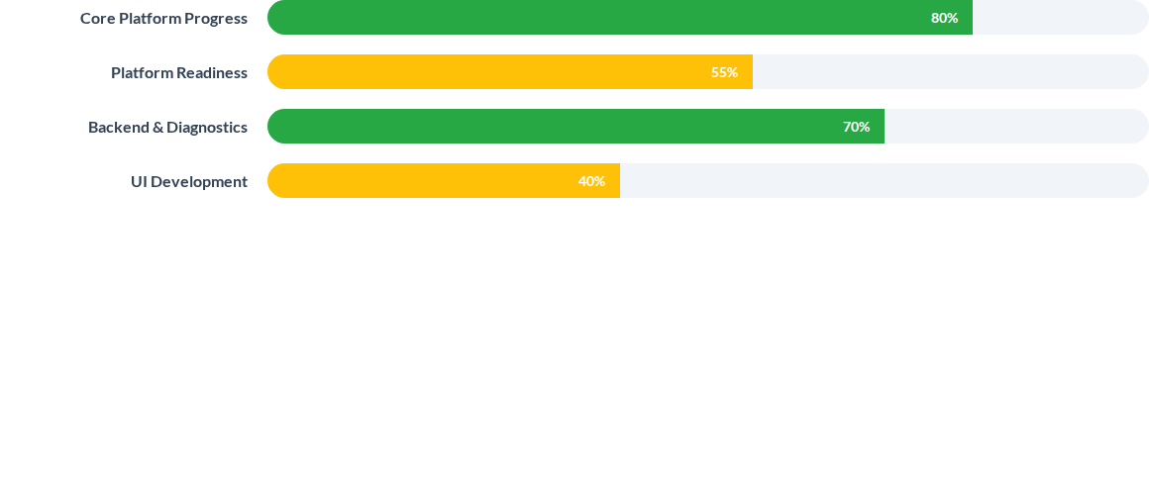
Platform Engineering: Progress Overview

Slide 7



Engineering Status: Risks & Mitigation
0%
3
Q4
Jenkins Uptime (Blocked)
Critical Resource Gaps
Target Readiness Date
Urgent support required from leadership to resolve infrastructure bottlenecks.

Slide 8

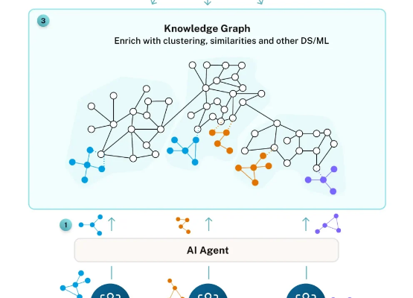
Core Capability Spotlight: GraphRAG
Advancing Knowledge Retrieval
The GraphRAG pipelines are the backbone of LEXI's intelligent retrieval capabilities. Current progress includes:
Automated pipeline schema generation.
Integration with TAFE data lakes.
Ongoing: Latency optimization for high-scale queries.

Slide 9
Leadership Decision Points
Strategic alignment required on Infrastructure & Resources

Slide 10
Next Week: Strategic Focus
Infrastructure Recovery: Finalizing Jenkins server temporary workaround or migration plan.
GraphRAG Validation: Completing accuracy testing for the Renault diagnostics module.
Samil Integration: Aligning with TAFE technical leads on bar chart metric representations.
SecOps Hardening: Implementing automated vulnerability patches in the dev environment.

Slide 11






Next Week: Key Deliverables
RAG Progress Report
Alpha Pipeline v2
TAFE Alignment
Detailed breakdown of task velocity following infra resolution.
Deployment of updated DevSecOps scanning gates.
Finalized specs for Samil % representation on platform UI.

Slide 12
Questions?
LEXI Platform Engineering & Strategy Team

Slide 13

Image Sources
https://dist.neo4j.com/wp-content/uploads/20251001155724/Accordion-5-992x1024.webp
Source: neo4j.com

